Slide 1

Banking Data Analysis in SQL
BY – SONU KUMAR SINGH
EMAIL – 11SONU113@GMAIL.COM
PHN - 8506995107

Slide 2
Project Documentation
1. Brief Description
This project involves analyzing customer transaction data from a bank to uncover various insights. The analysis includes identifying inactive customers, summarizing transaction amounts, ranking branches, and detecting potential fraudulent activities.
2. Problem Statement or Objectives
Identify customers who haven't made any transactions in the last year.
Summarize the total transaction amount per account per month.
Rank branches based on the total amount of deposits made in the last quarter.
Find the name of the customer who has deposited the highest amount.
Identify accounts that have made more than two transactions in a single day, which could indicate fraudulent activity.
Calculate the average number of transactions per customer per account per month over the last year.
Find the daily transaction volume for the past month.
Calculate the total transaction amount performed by each age group in the past year.
Find the branch with the highest average account balance.
Calculate the average balance per customer at the end of each month in the last year.

Slide 3
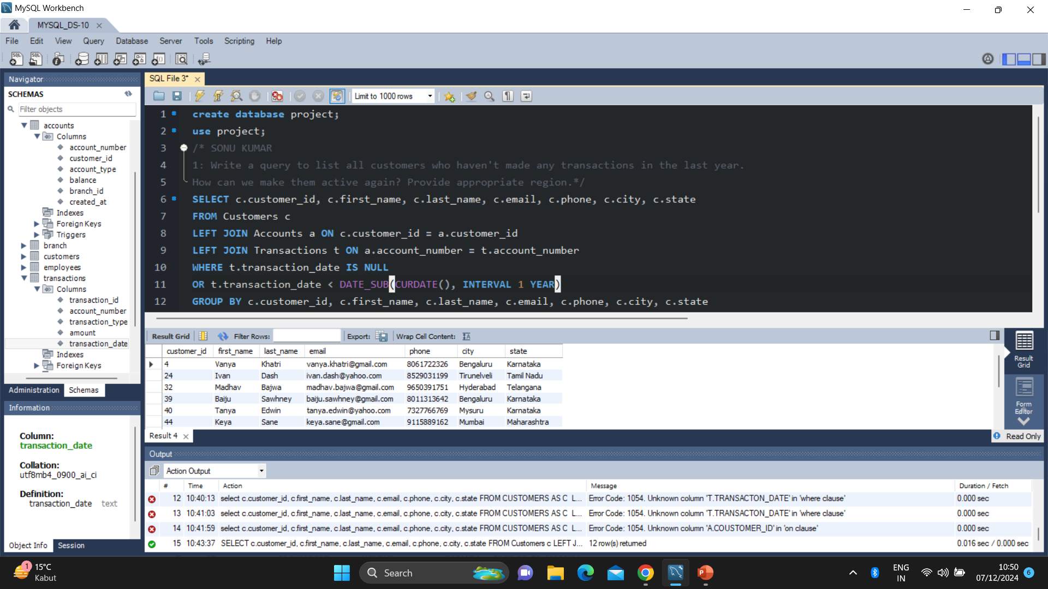
1. Write a query to list all customers who haven't made any transactions in the last year.
SONU KUMAR SINGH

Slide 4
SONU KUMAR SINGH.
How can we make them active again? Provide appropriate region?
Strategies to Make Customers Active Again
To re-engage these inactive customers, you could consider the following strategies:
Personalized Communication:
Send personalized emails or messages to remind them of their account benefits.
Inform them of any new features or services.
Incentives and Offers:
Provide special offers or incentives such as cash bonuses, lower fees, or interest rate promotions for making transactions.
Offer loyalty programs or rewards for frequent transactions.
Educational Campaigns:
Educate customers about the importance of using their accounts regularly.
Offer financial planning seminars or webinars to encourage more activity.
Customer Feedback:
Conduct surveys to understand why they are inactive and address any issues they raise.
Use their feedback to improve services.
Enhanced Services:
Introduce new services or products that may interest them.
Ensure your digital banking services are user-friendly and accessible.
By implementing these strategies, you can encourage inactive customers to become active again, improving customer retention and engagement.

Slide 5
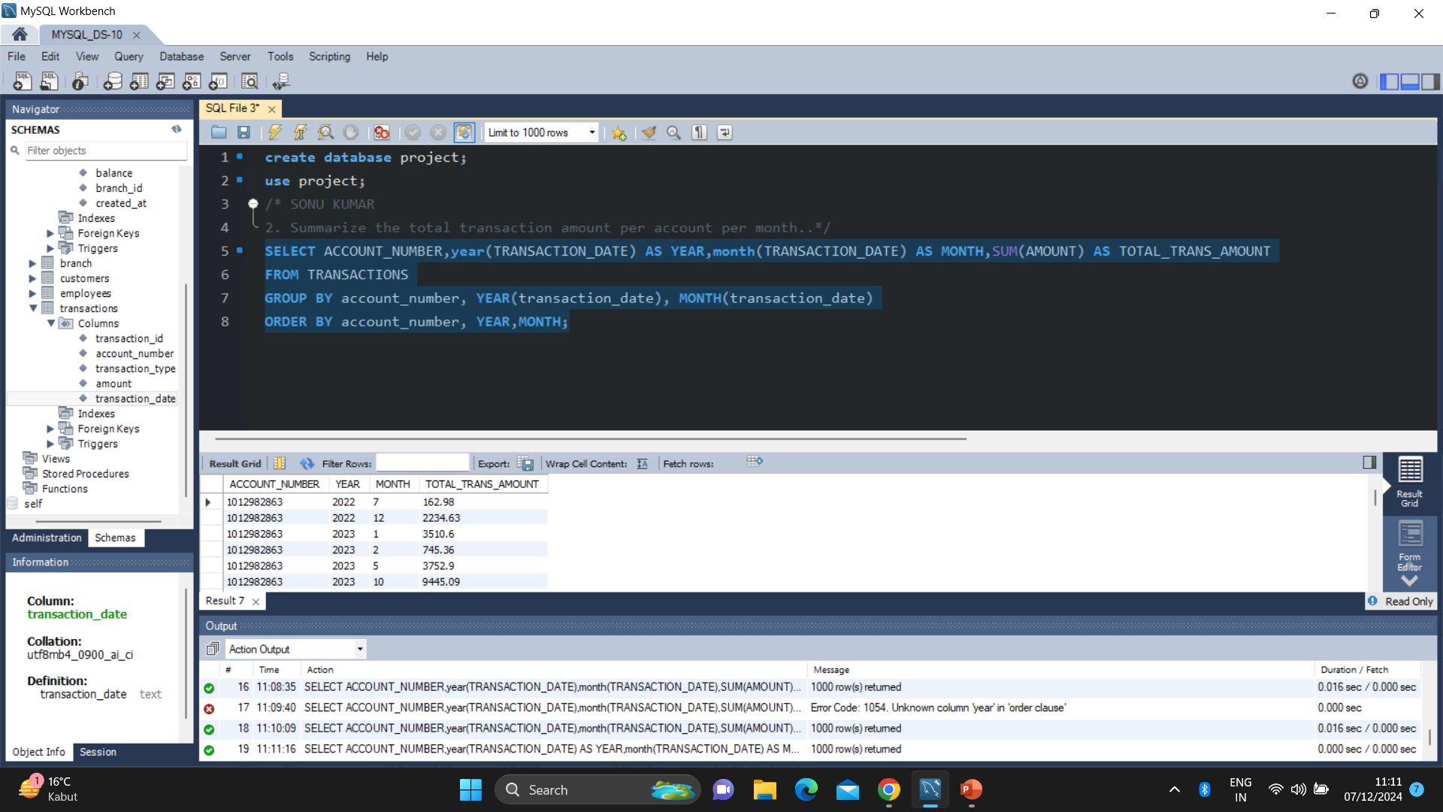
2. Summarize the total transaction amount per account per month.
SONU KUMAR SINGH

Slide 6
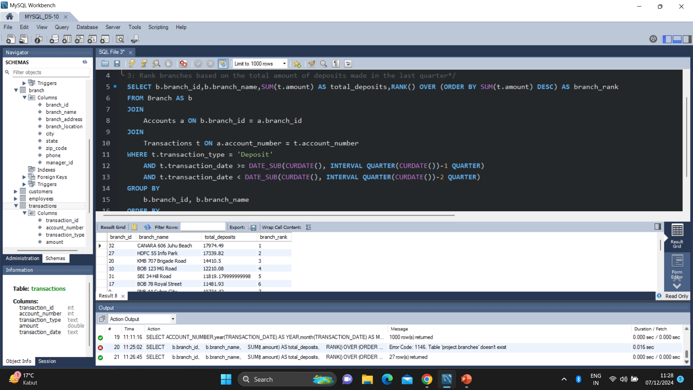
3: Rank branches based on the total amount of deposits made in the last quarter
SONU KUMAR SINGH

Slide 7
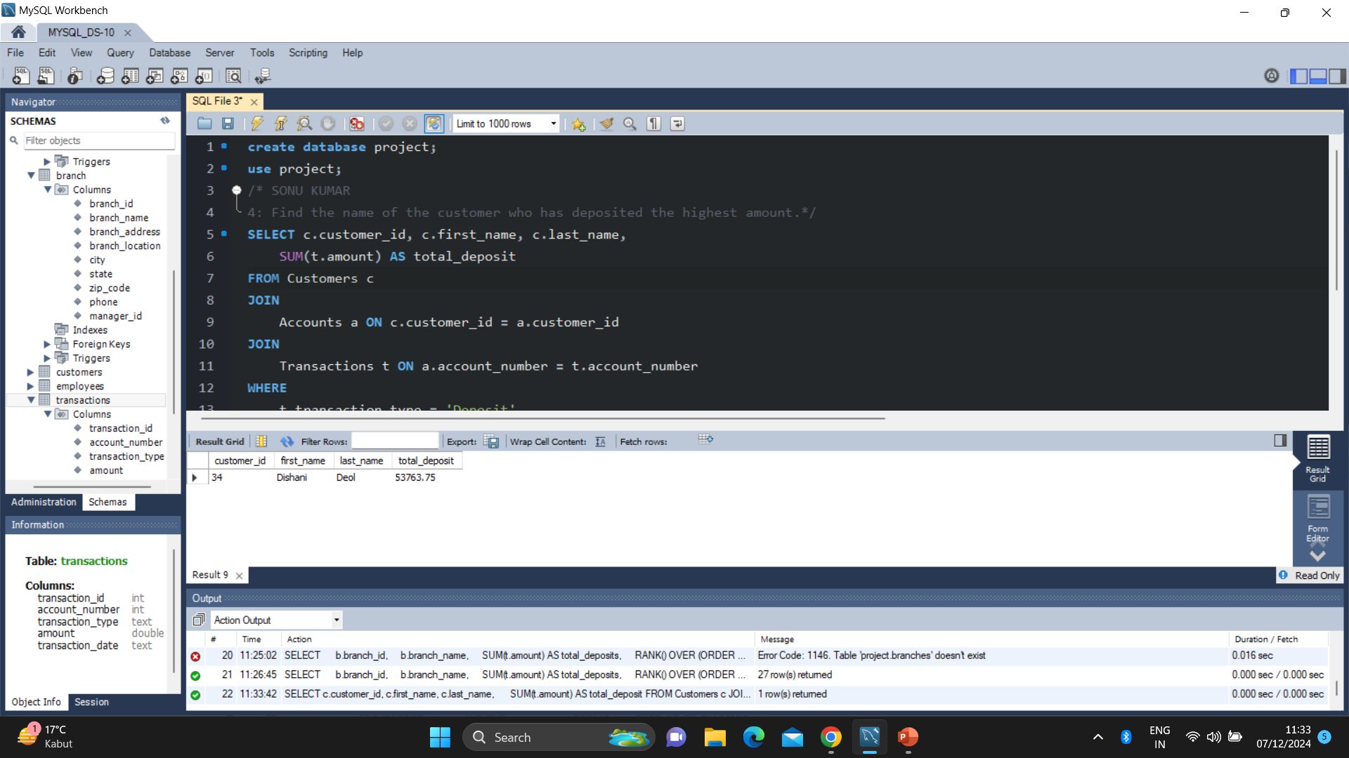
4: Find the name of the customer who has deposited the highest amount.
SONU KUMAR SINGH

Slide 8
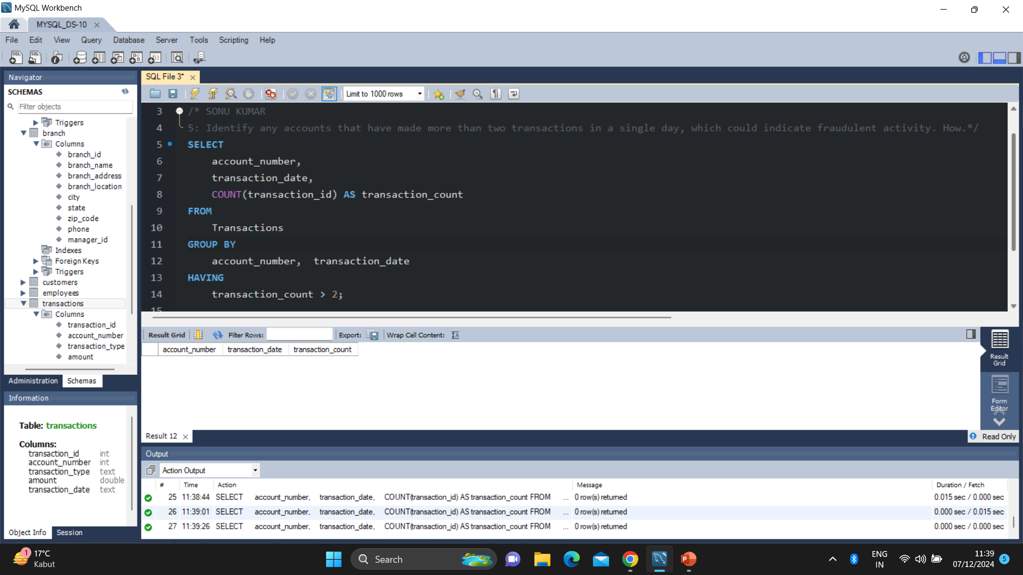
5: Identify any accounts that have made more than two transactions in a single day, which could indicate fraudulent activity. How.
SONU KUMAR SINGH

Slide 9
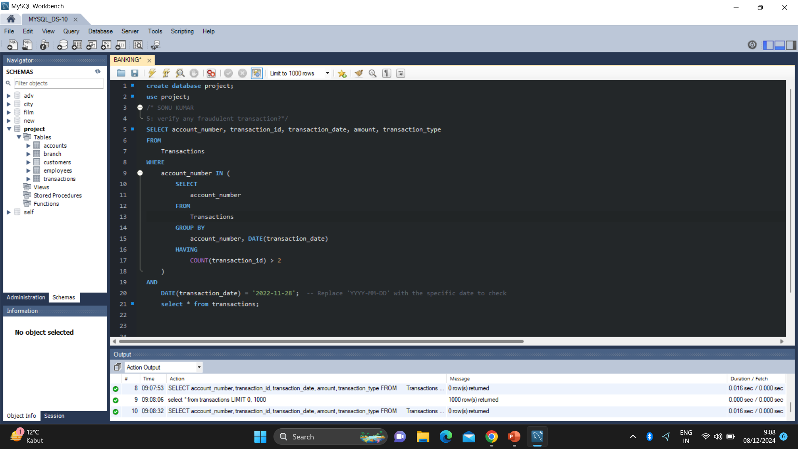
can you verify any fraudulent transaction?
Sonu kumar singh

Slide 10
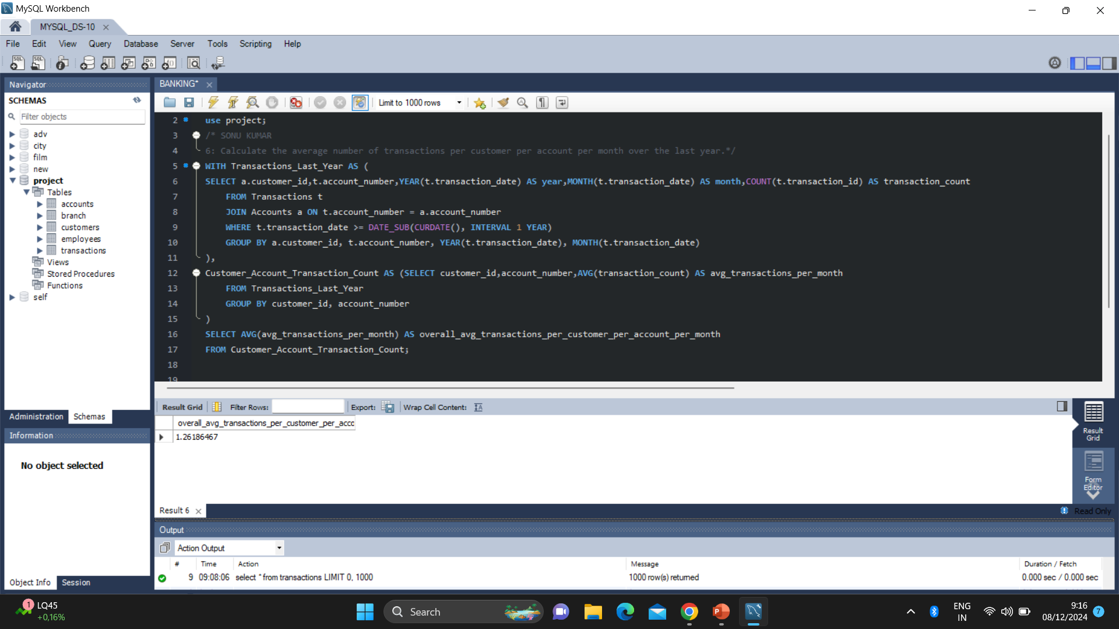
6: Calculate the average number of transactions per customer per account per month over the last year
Sonu kumar singh

Slide 11
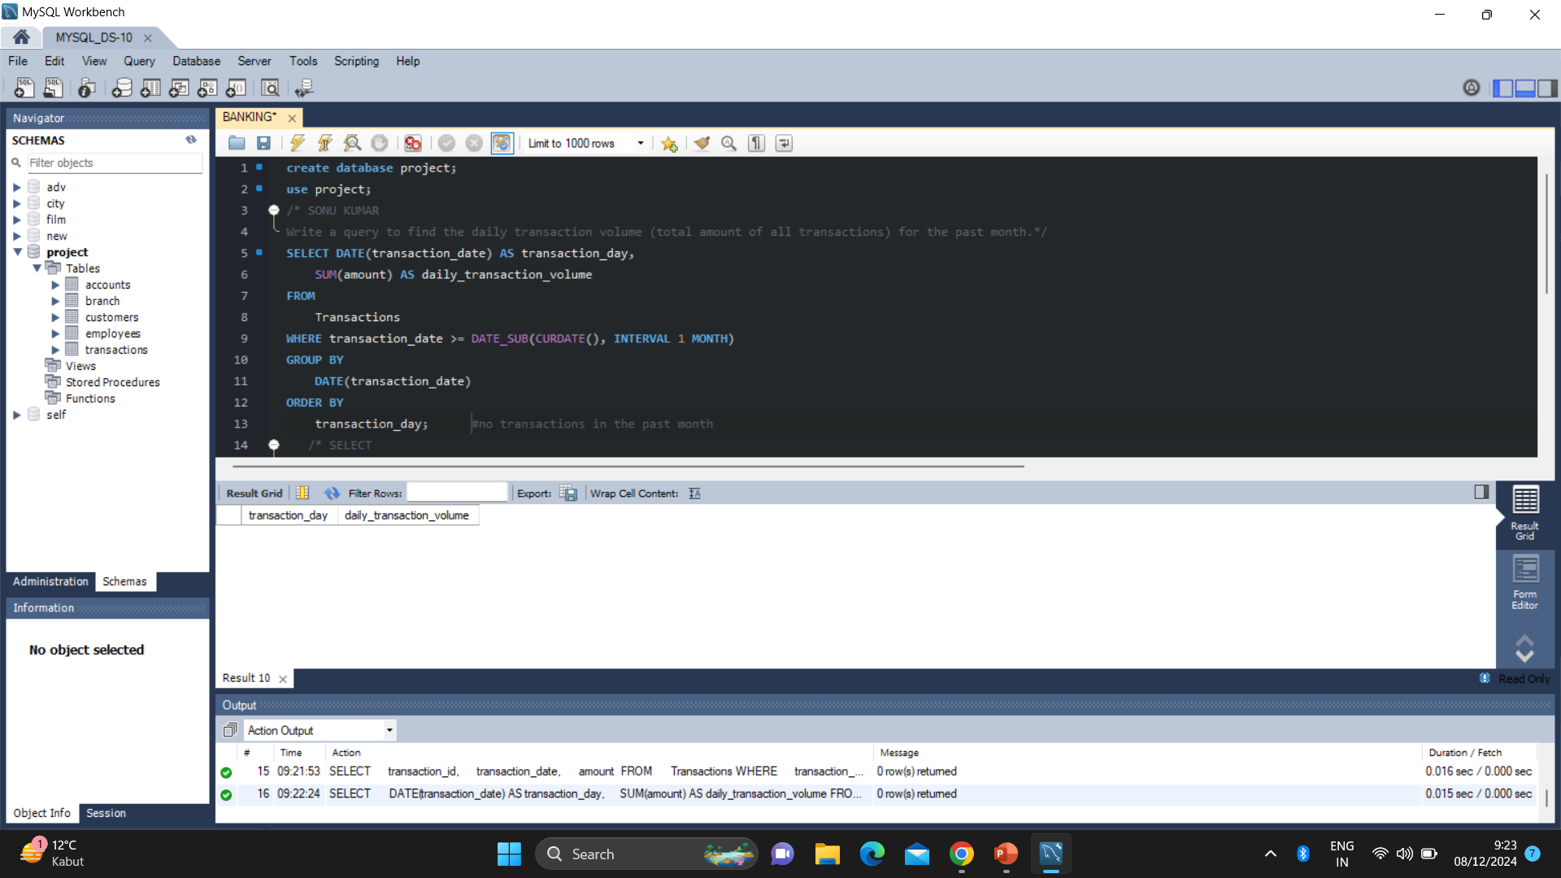
Write a query to find the daily transaction volume (total amount of all transactions) for the past month
Sonu kumar singh
no transactions in the past month

Slide 12
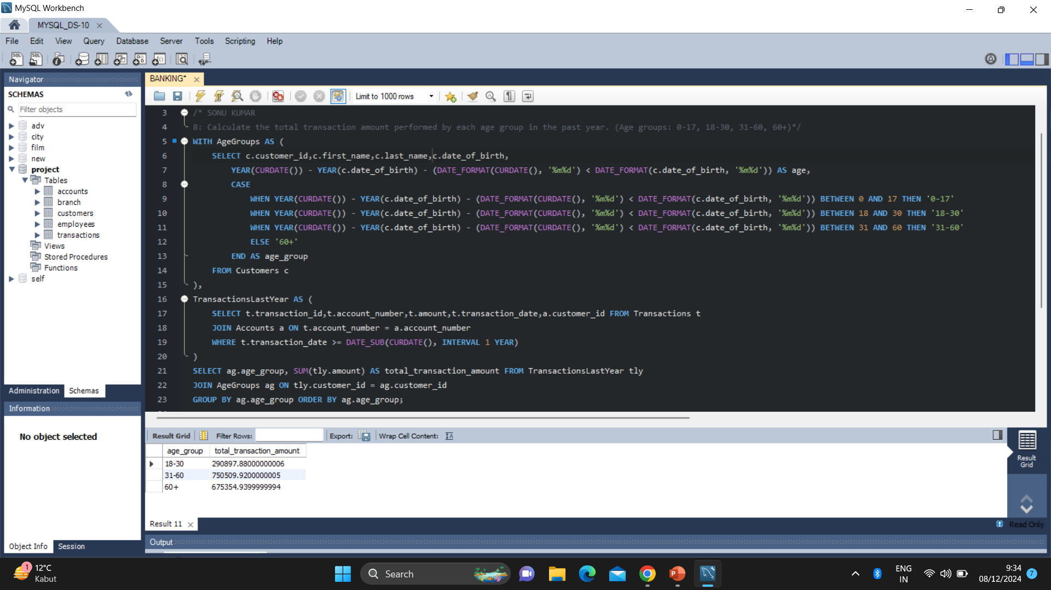
8: Calculate the total transaction amount performed by each age group in the past year. (Age groups: 0-17, 18-30, 31-60, 60+)
Sonu kumar singh

Slide 13
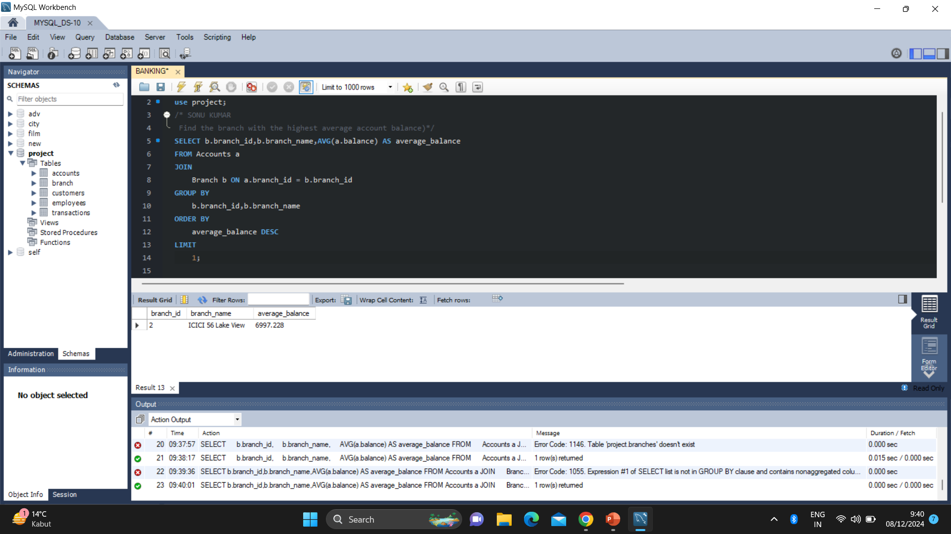
10.Find the branch with the highest average account balance
Sonu kumar singh

Slide 14
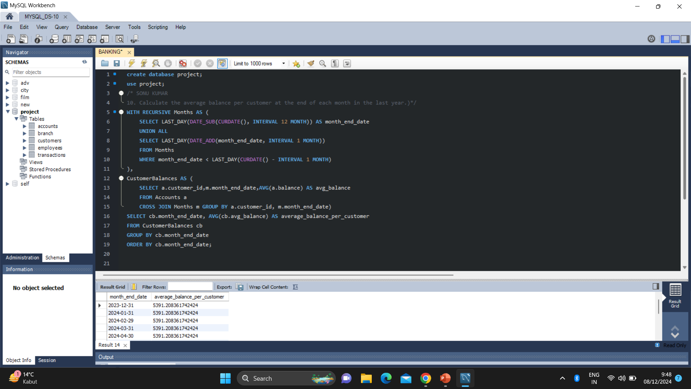
10. Calculate the average balance per customer at the end of each month in the last year
Sonu kumar singh

Slide 15


